Slide 1
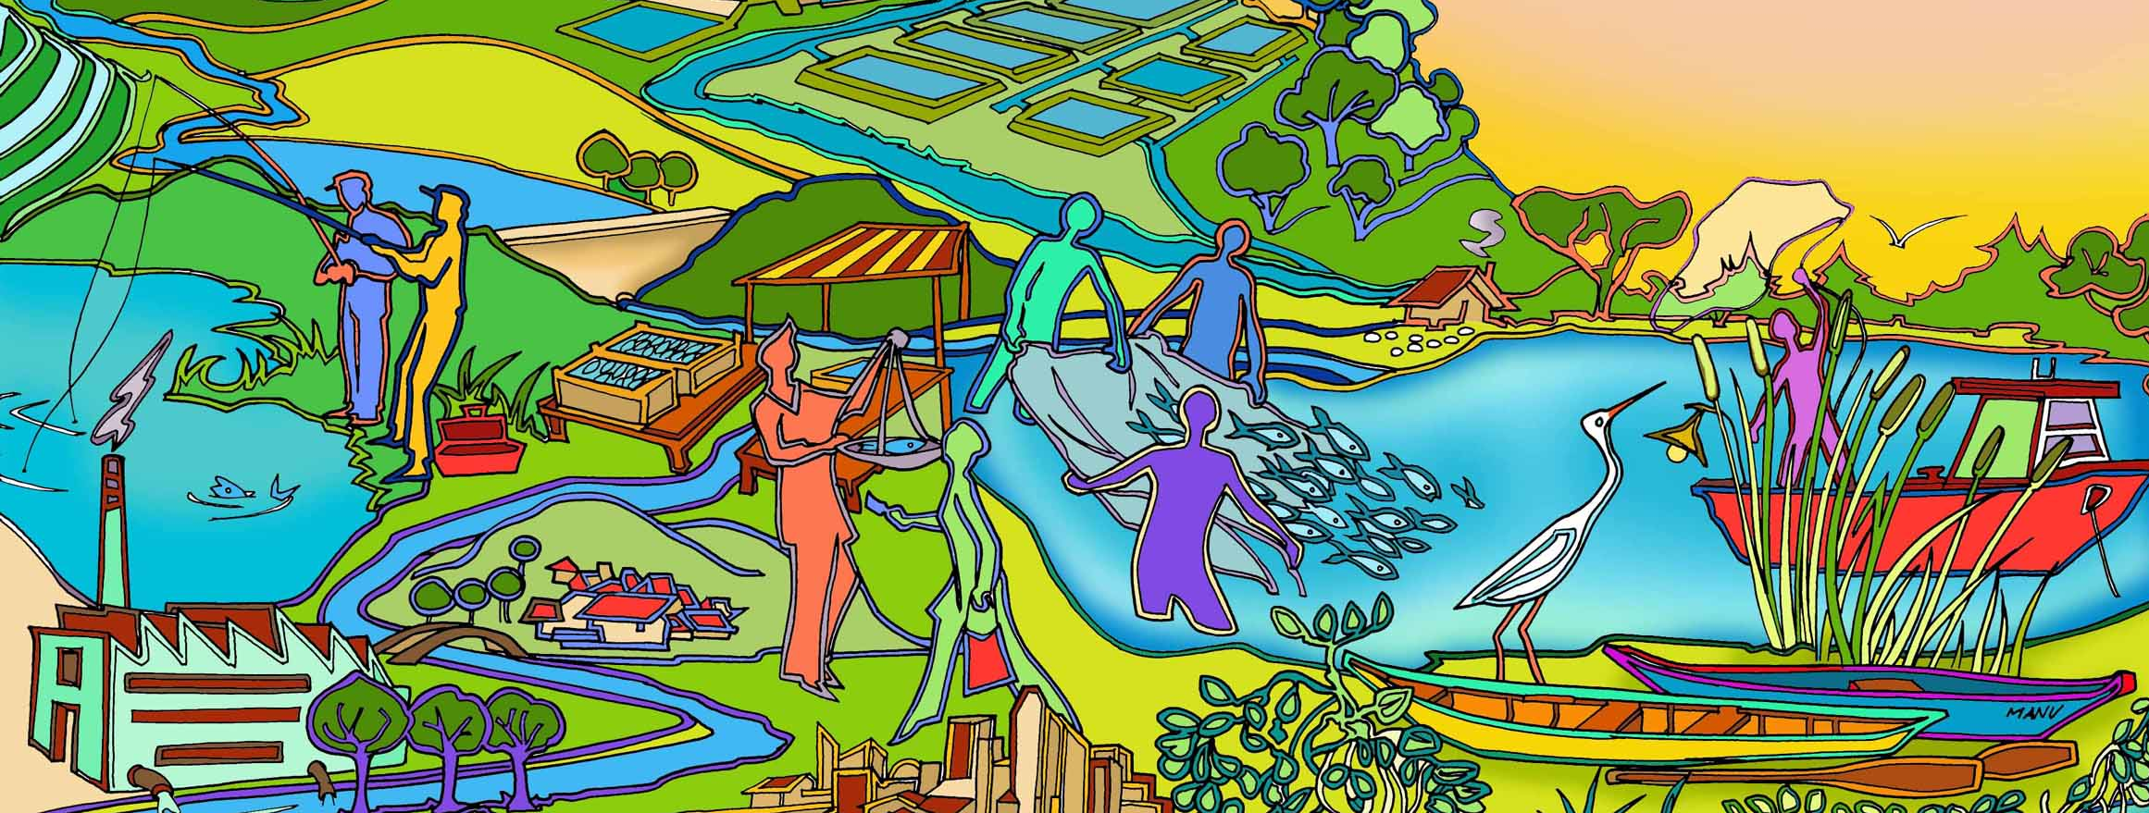
Session 16 Reality Check II
Essential EAFm training
Date |Place

Slide 2
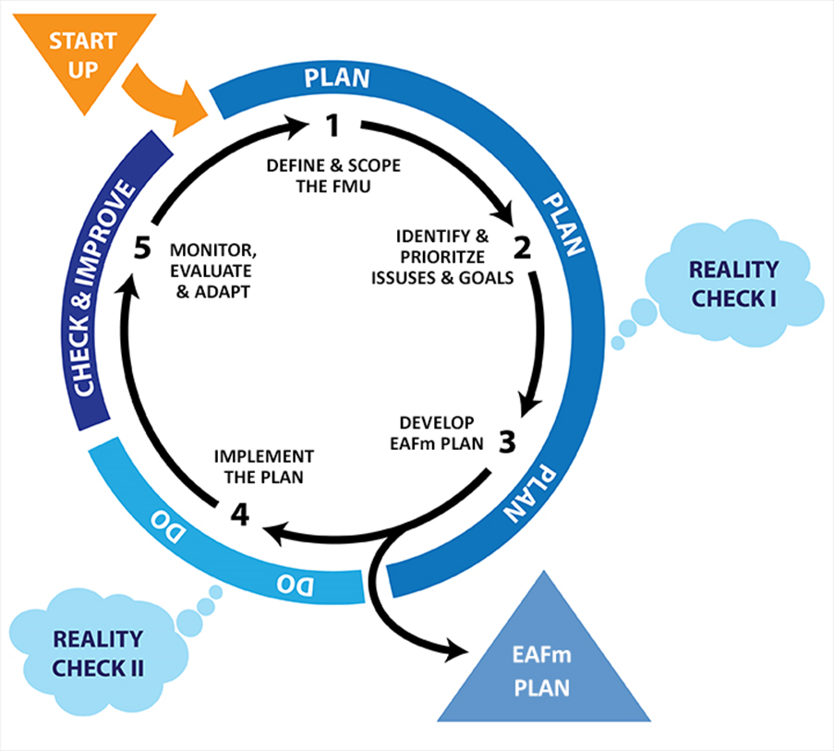
Notes:
Early in the implementation Step 4, we need to step back and do Reality Check II.
Refer to large Flipchart of this on wall to keep up as reference throughout course. Show where we are in course.

Slide 3
Session Objectives
After this session you will be able to:
Check on the status of the EAFm plan implementation
Consider whether implementation is in line with the principles of EAFm
Check on the practicalities – is the supporting environment in place?
Re-visit constraints and opportunities in meeting your FMU goals
Notes:
Self explanatory
Note:
Management need be broad and include all the important (priority issues) threats and issues.

Slide 4
Reality Check II
Check on whether the main mechanisms, processes, resources and institutions for EAFm implementation are in place
Notes:
This is a check on whether you have all the building blocks in place to implement the EAFm Plan.
Module 16 explains all elements in much greater detail. Many of these resources were discussed when we considered the principles of EAFm and during the Startup processes but now it is time to reflect.

Slide 5
Key Principles of EAFm
1. Good governance
2. Appropriate scale
3. Increased participation
4. Multiple objectives
5. Cooperation & coordination
6. Adaptive management
7. Precautionary approach
Notes:
There are 7 principles. At this stage of the course simply read these out (Note P1 = Principle 1). These are expanded on later.
P1: Good governance
P2: Appropriate scale
P3: Increased participation
P4: Multiple objectives
P5: Cooperation and coordination
P6: Adaptive management
P7: Precautionary approach

Slide 6
The Key : Good Governance
Consensus
GOOD GOVERNANCE
Participatory
Accountable
Follows the rule of law
Transparent
Effective and efficient
Equitable and inclusive
Responsive
Source: http://www.unescap.org/pdd/prs/ProjectActivities/Ongoing/gg/governance.asp
Notes:
Good governance is the key to an effective implementation of EAFm. As seen earlier good governance includes: effective institutions and arrangements for setting and implementing rules and regulations. This slide shows 8 characteristics of good governance. Discuss each of these; ensure participants agree with meaning. See Module 4 for details on each of these 8 characteristics.
(Accountability = both upwards and downwards)
Diagram from http://www.unescap.org/pdd/prs/ProjectActivities/Ongoing/gg/governance.asp

Slide 7
Governance Check List
Is the legal framework supporting EAFm?
Are rules and regulations in place and agreed to by stakeholders?
Do we have capacity for effective compliance and enforcement?
Are effective governance arrangements in place for coordination and cooperation?
Notes:
A governance check list could include questions….:
Is the legal framework supporting EAFm?
Are rules and regulations in place and agreed to by stakeholders?
Do we have effective compliance and enforcement?
Are effective governance arrangements in place for coordination and cooperation?

Slide 8
Check co-ordination & co-management Arrangements
Community
VC
VC
VC
VC = Village Management Committee
MAC: Management Advisory Committee
Fisher association
District
MAC
MAC
MAC
Provincial
FMU MAC
Other sectors
Department of Fisheries
Police/Courts
Department of Environment
National
Council
Notes:
This is just an example of governance arrangements that could lead to better coordination and cooperation.
Starting at the community level we have Village Committees. At the next level we have MACs (Management Advisory Committees) that link with a Provincial FMU MAC. At the national level we have a Council that covers at least fisheries, and the environment agency.
Refer to Participant Handbook Module 16, Figure 16.2.

Slide 9
Other Success Factors
Checking against the other principles also help us ask important questions, such as:
Does the plan cover multiple objectives?
Are we working at the right scale?
Is co-management with empowered stakeholders built into the plan?
Do we have a system for learning through adaptive management?
Are there any major risks with our proposed actions?
Notes:
Checking against the other principles also help us ask important questions, such as:
Are we working at the right scale?
Is co-management working through empowered stakeholders?
Are we learning through adaptive management?

Slide 10
Also need: a supporting environment
Adequate political will and support?
Adequate resources (personnel, equipment, finances) for EAFm?
Effective financing mechanisms?
Appropriate institutional arrangements
Notes:
In addition to the checklist based on the EAFm principles, we also need a SUPPORTING ENVIRONMENT. Do we have
Adequate political will and support?
Adequate resources (personnel, equipment, finances) for EAFm?
Effective financing mechanisms?
Appropriate institutional arrangements

Slide 11
Adequate Political Will
Key questions when checking on political will:
Have the politician/senior policy makers been engaged in the EAFm planning process?
Have clear messages for politician/senior policy makers been communicated and understood?
Notes:
With respect to political will,
Key questions will include:
Have the politician/senior policy makers been engaged in the EAFm planning process?
Have clear messages for politician/senior policy makers been communicated and understood?

Slide 12
Adequate Resources
Key questions when checking on human resources:
Do the staff responsible for implementing EAFm have appropriate experience and training?
Is the implementing team equipped with “people skills” to facilitate a process that maximizes the benefits of a having a truly participatory process?
Notes:
With respect to adequate resources,
Key questions will include:
Have the politician/senior policy makers been engaged in the EAFm planning process?
Have clear messages for politician/senior policy makers been communicated and understood?

Slide 13
Effective Financing Mechanisms
Key questions when checking on financing:
Has the implementation of the EAFm plan been mainstreamed into the activities and tasks of the relevant agencies
Has an annual budget been allocated?
Have other sources and models for funding (e.g. “user pays”) been adequately investigated?
Notes:
With respect to financing mechanisms,
Key questions will include:
With respect to political will,
Key questions will include:
Have the politician/senior policy makers been engaged in the EAFm planning process?
Have clear messages for politician/senior policy makers been communicated and understood?

Slide 14
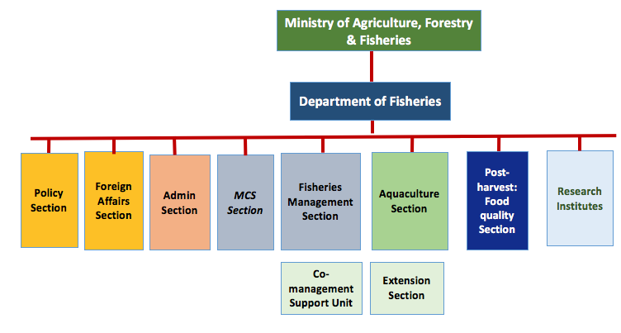
Is the Fisheries Agency Structure supportive?
Notes:
In terms of appropriate institutional arrangements, we may have to look at our fisheries agency structure and make changes.
Typically, the fisheries agency (called Department of Fisheries in this example) consists of a number of Sections or Divisions. In this example they include (i) an Administrative Section, (ii) a Post-harvest section, (iii) a foreign affairs section , (iv) a policy section and (v) research institutes. Importantly, a compliance and enforcement section (here called MCS) and a fisheries management section are often missing. A fisheries management section that gives a legitimate home to fisheries managers who are responsible for coordinating all the different fisheries management activities for a given fishery.
Refer to Participant Handbook Module 16, Figure 16.3.

Slide 15
Key Messages
In Reality Check II:
Check whether everything is in order before putting too much of the EAFm plan into action
Consider whether the EAFm principles are being met, especially good governance
Check whether the practical arrangements are in place (i.e. the supporting environment)
Notes:
Self explanatory

Slide 16
Activity: As a Large Group
Take the “constraints” (challenges) and “opportunities” you developed earlier
Place the opportunities on the floor inside the circle and the constraints outside the circle
Can you move the constraints into the opportunity circle (i.e. change constraints into opportunity)?
For the constraints that still exist discuss what is needed to overcome them.
Notes:
See details in Session Plan. Plenary activity: revisit challenges (constraints) and opportunities developed in session 5 (for fisheries management in your country) and refined in session 12 (for achieving your FMU goals).
Make a string circle on the floor at back of the room (as big as 2-3 flipcharts). Groups place their (yellow) opportunity cards inside the circle, and their (green) challenges cards outside the circle. All walk around and re-read cards. Trainer reminds that these are their own-identified constraints and opportunities to achieving FMU goals. Facilitate a discussion, asking: “Now that we understand more about EAFm cycle, consider: are constraints/challenges still valid?” Consider each constraint card in turn, and ask participants’ opinions. Have some constraints become opportunities? (if so, take the card and place inside the circle); others may considered less serious and so can be moved closer to the circle. How can remaining constraints be addressed? Discuss opportunities, are there any more?
End on a positive note as many of the constraints are likely to be moved. Record outputs in Workbook.

